Slide 1
FINAL PROJECT A Content Moderator AI Agent using retrieval-augmented generation
CSCI-6908-NLP Name: Mohd Faizan
Dal ID: B00966320

Slide 2
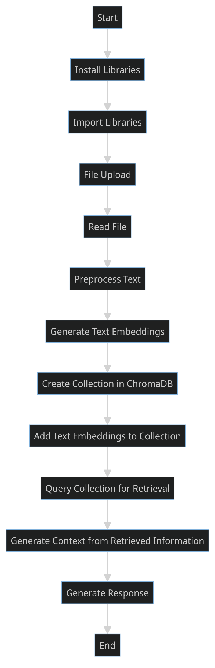
Fig 1: workflow
What is retrieval-augmented generation ?
Enhances the quality and relevance of AI-generated text.
Merges information retrieval with advanced natural language processing.
Supports complex question-answering with in-depth and accurate responses.
Empowers a variety of AI-driven applications with up-to-date and context-rich content.
High level Workflow

Slide 3
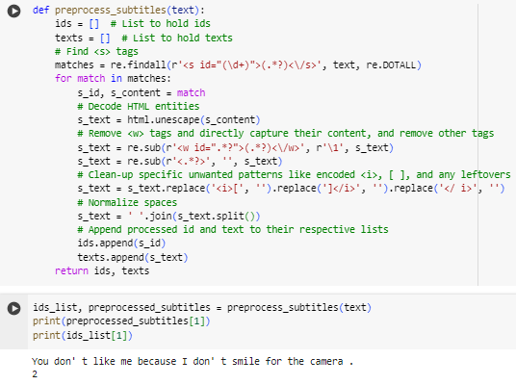
Text preprocessing
HTML Tags and Entities Handling
Text Extraction and Cleanup
Data Structuring
Fig 2: preprocessing

Slide 4
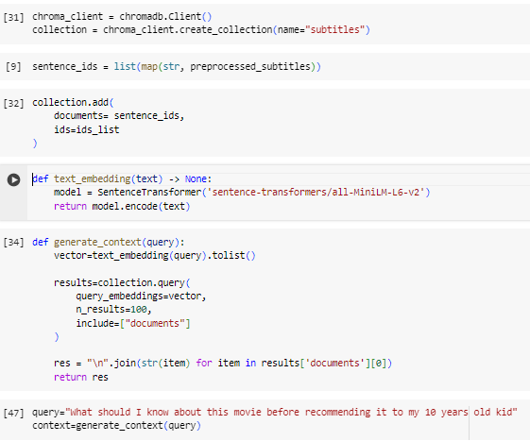
Text Embedding and Retrieval
Collection Creation
Embedding (model all-MiniLM-L6-v2 )
Context Generation
Query Execution
Fig 3: Embedding and retrieval

Slide 5
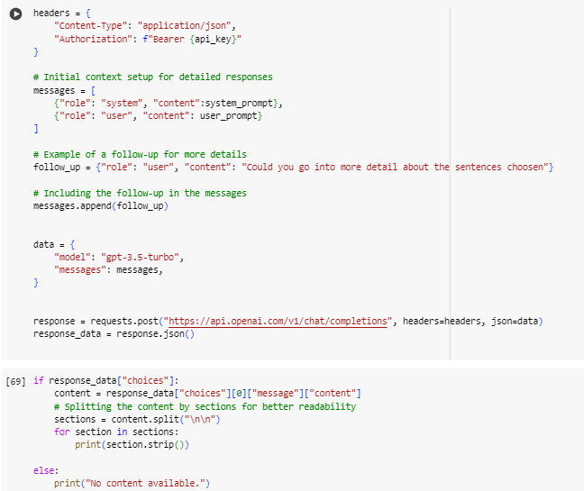
Generative Model
Conversation Setup
Message Expansion
API Request
Response Handling
Fig 4: Generative model

Slide 6
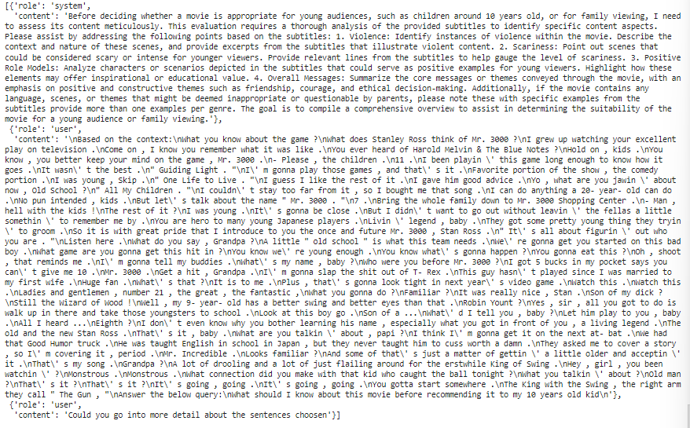
Final prompt given to the LLM ( Mr. 3000 )

Slide 7
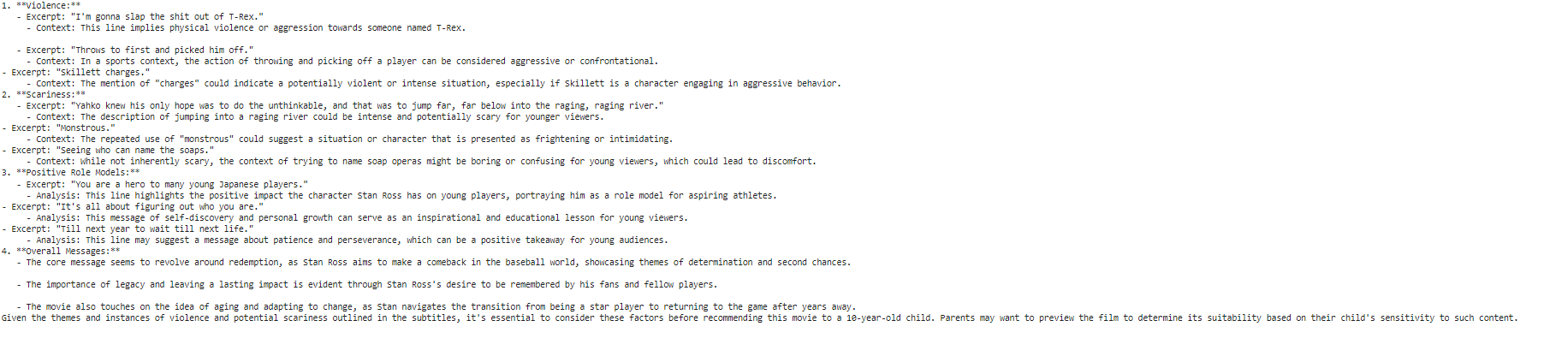
Out given using gpt-3.5-turbo

Slide 8
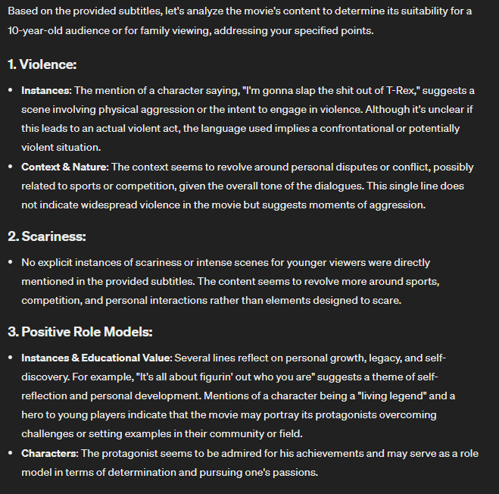
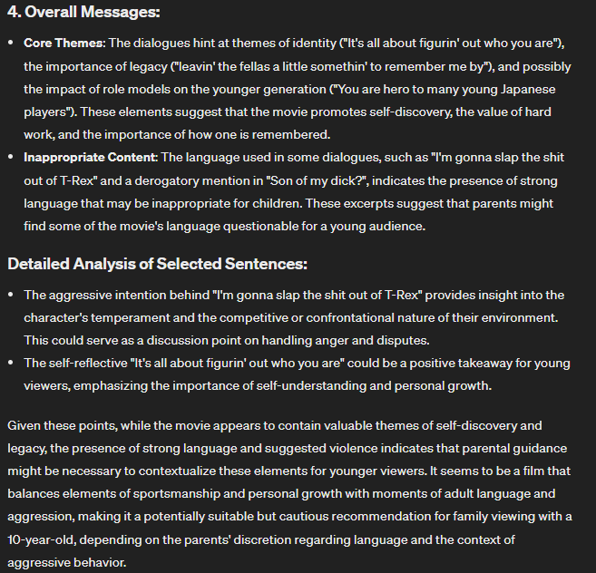
Out given using gpt-4

Slide 9

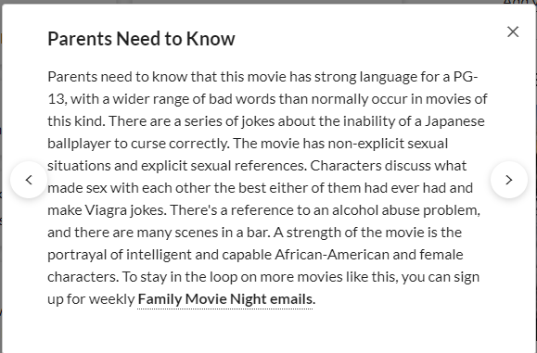
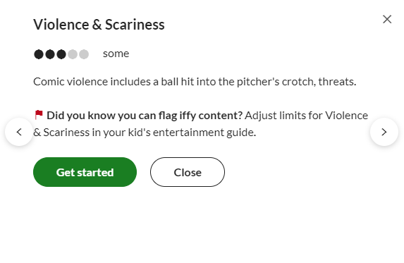



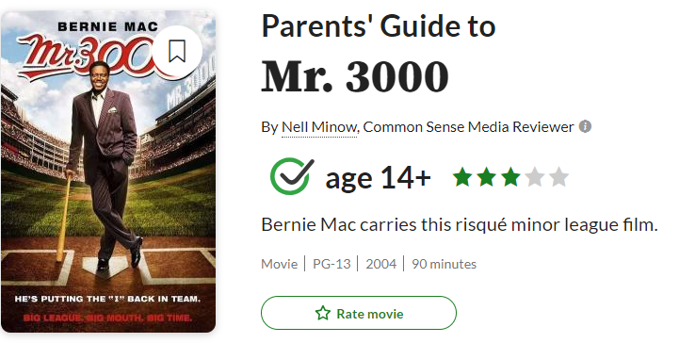

Validation

Slide 10
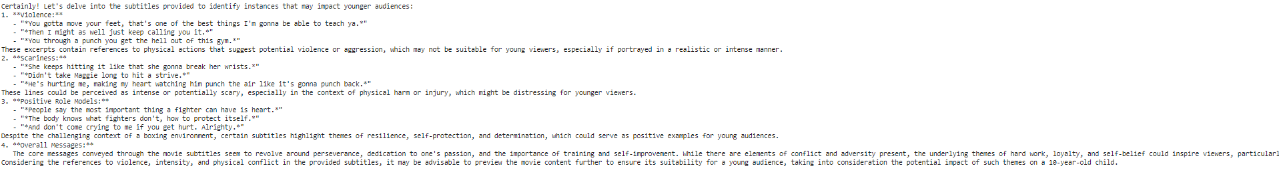
Out given using gpt-3.5-turbo [ Movie: Million Dollar Baby ]

Slide 11
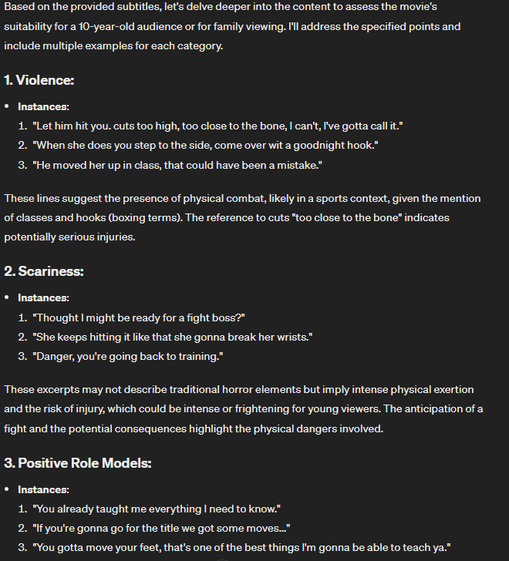
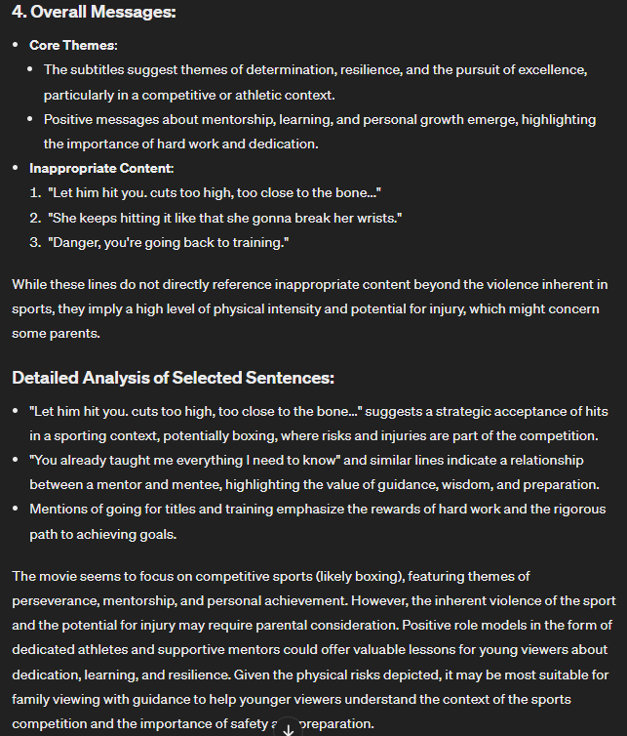
Out given using gpt-4

Slide 12

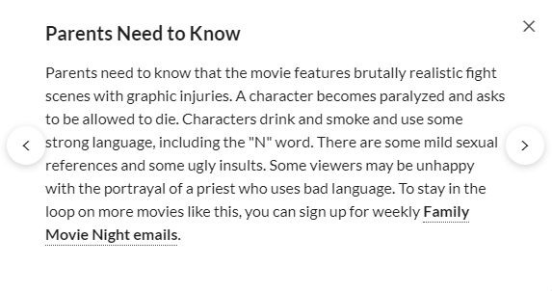
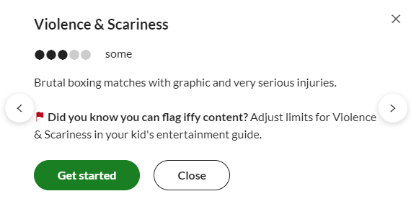

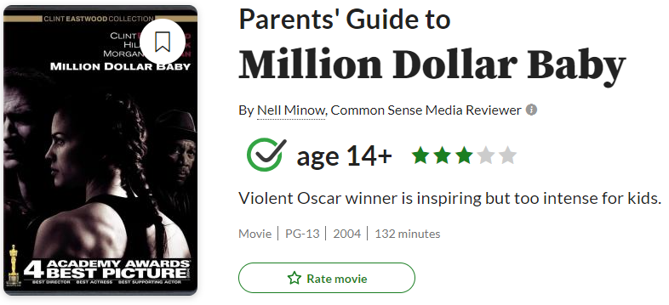
Validation

Slide 13
Conclusion
Successfully extracted dialogues from the source material and rationalized their categorical classification.
Capable of furnishing comprehensive contextual background for every identified genre within a cinematic work.
Ensured the elimination of any non-factual content creations, commonly referred to as 'hallucinations,' in the generation process.
Maintained accuracy and relevance to the context in the content generation.

Slide 14
References
[1] Y. Gao et al., “Retrieval-augmented generation for large language models: A survey,” Arxiv.org. [Online]. Available: http://arxiv.org/abs/2312.10997. [Accessed: 04-Apr-2024].
[2] “OpenAI,” Openai.com. [Online]. Available: https://openai.com/. [Accessed: 05-Apr-2024].
[3] “Colab.Google,” colab.google. [Online]. Available: https://colab.google/. [Accessed: 06-Apr-2024].
[4] “Online FlowChart & diagrams editor - mermaid live editor,” Mermaid.live. [Online]. Available: https://mermaid.live/edit. [Accessed: 07-Apr-2024].

